Slide 1
Declaring a State of Emergency on Homelessness in Alameda County
Alameda County Supervisor Nate Miley, District 4
President, Alameda county Board of Supervisors

Slide 2
A Homelessness Crisis
In Alameda County

Slide 3
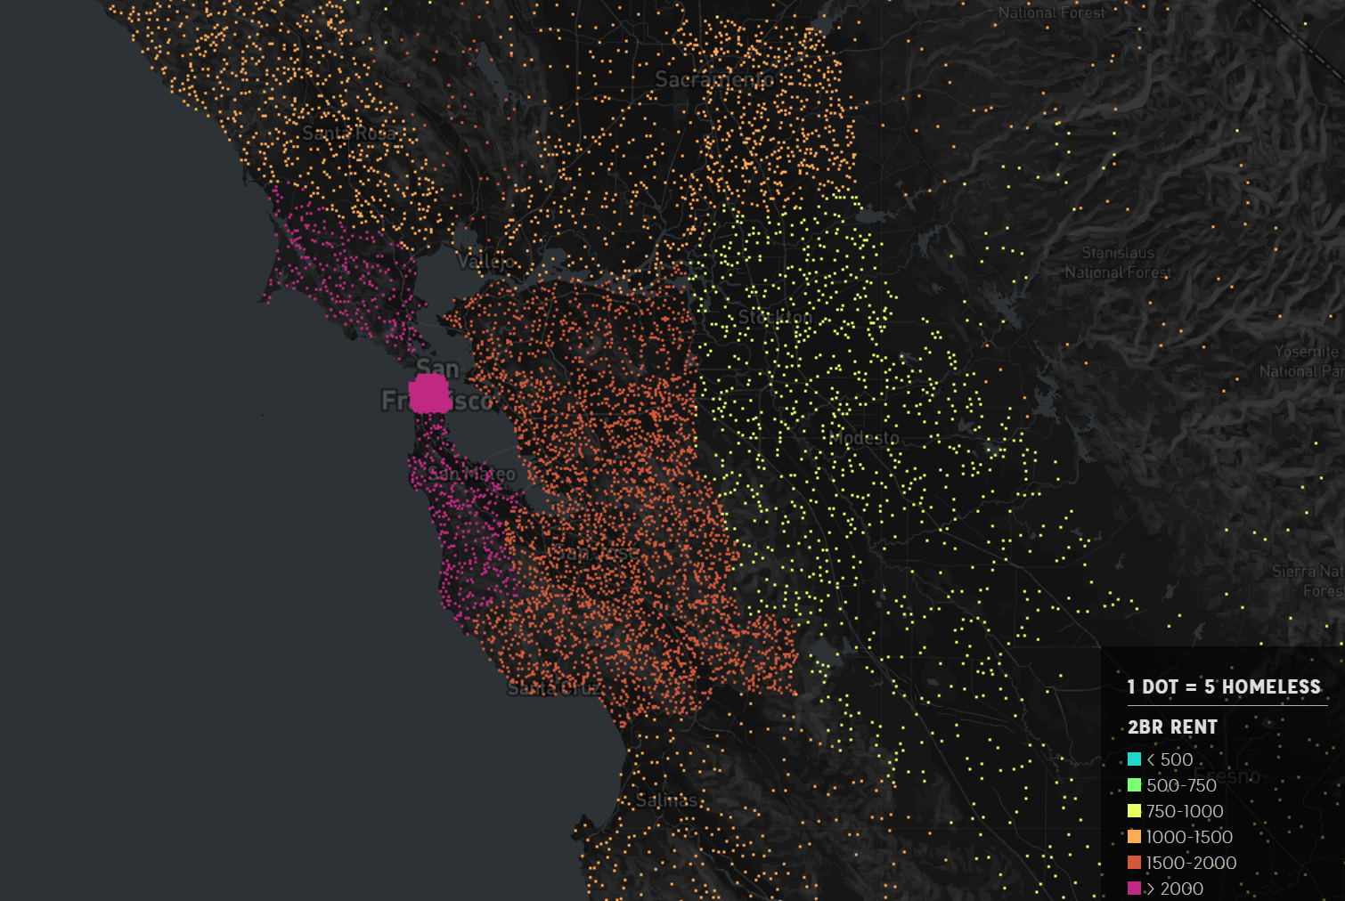
Homelessness is concentrated in areas with large populations and high cost of housing.
These factors are driving the crisis in Alameda County.

Slide 4
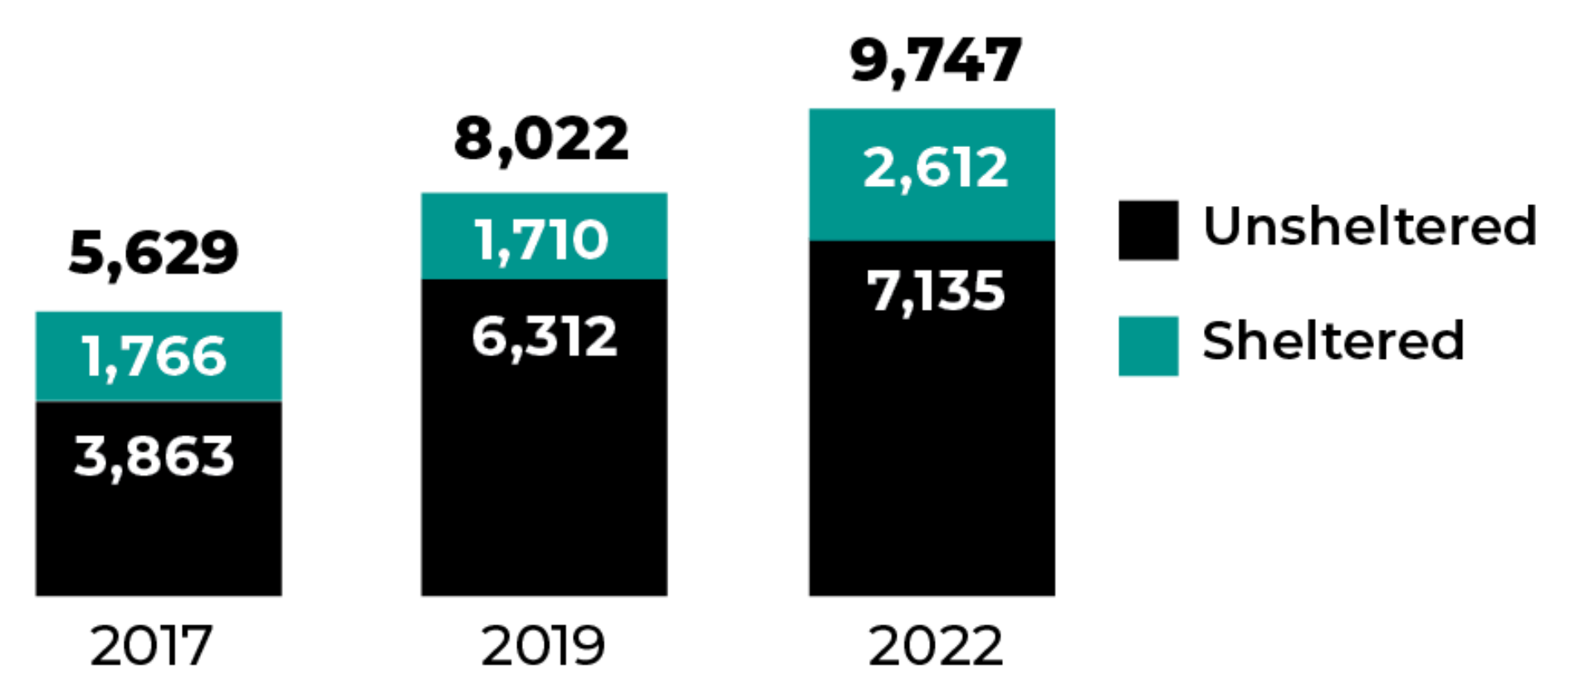
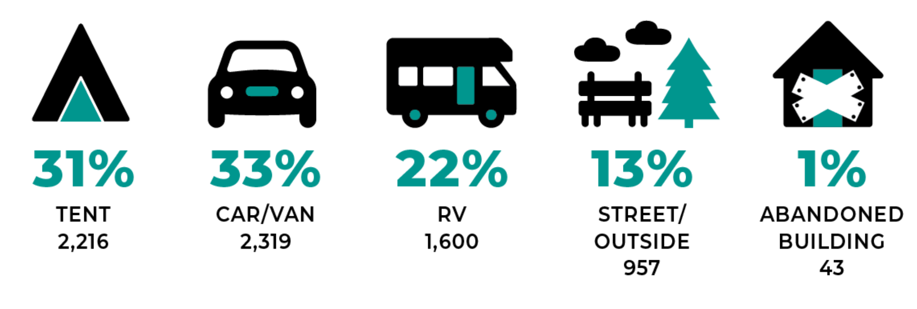
The Homelessness Crisis in Alameda County is Growing
PIT Count of Alameda County Homeless Population:
The 2020 Point In Time (PIT) Count interviewed 1,517 and counted 9,747 people experiencing homelessness, across all of Alameda County and in a variety of living situations.
82% Lived in Alameda County at the time they became homeless.
68% had lived in Alameda County for at least 10 years when they became homeless.
Every year the scale of the Homelessness Crisis increases.
There has been a 22% increase since 2019.
There has been a 73% increase since 2017.
Where they live:

Slide 5
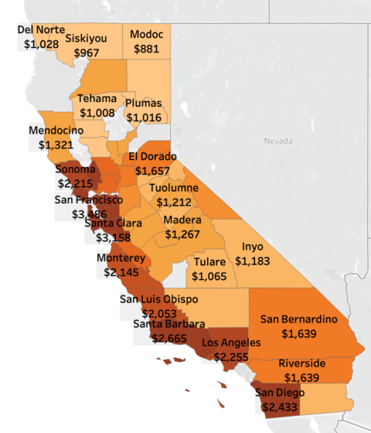
What's Driving the Rise in Homelessness?
Median Rent for Two-Bedroom Apartment in California, 2022
The lead indicator associated with homelessness is Cost of Housing.
As the cost of housing goes up, homelessness increases.
The median rent for a two-bedroom apartment in the Bay Area is well over $3,000 per month.
More than 2.5X the national average: $1,200.
The medium rent for a studio in Alameda County is $1,583 per month.
SSDI maximum payment is $1,033 per month.

Slide 6
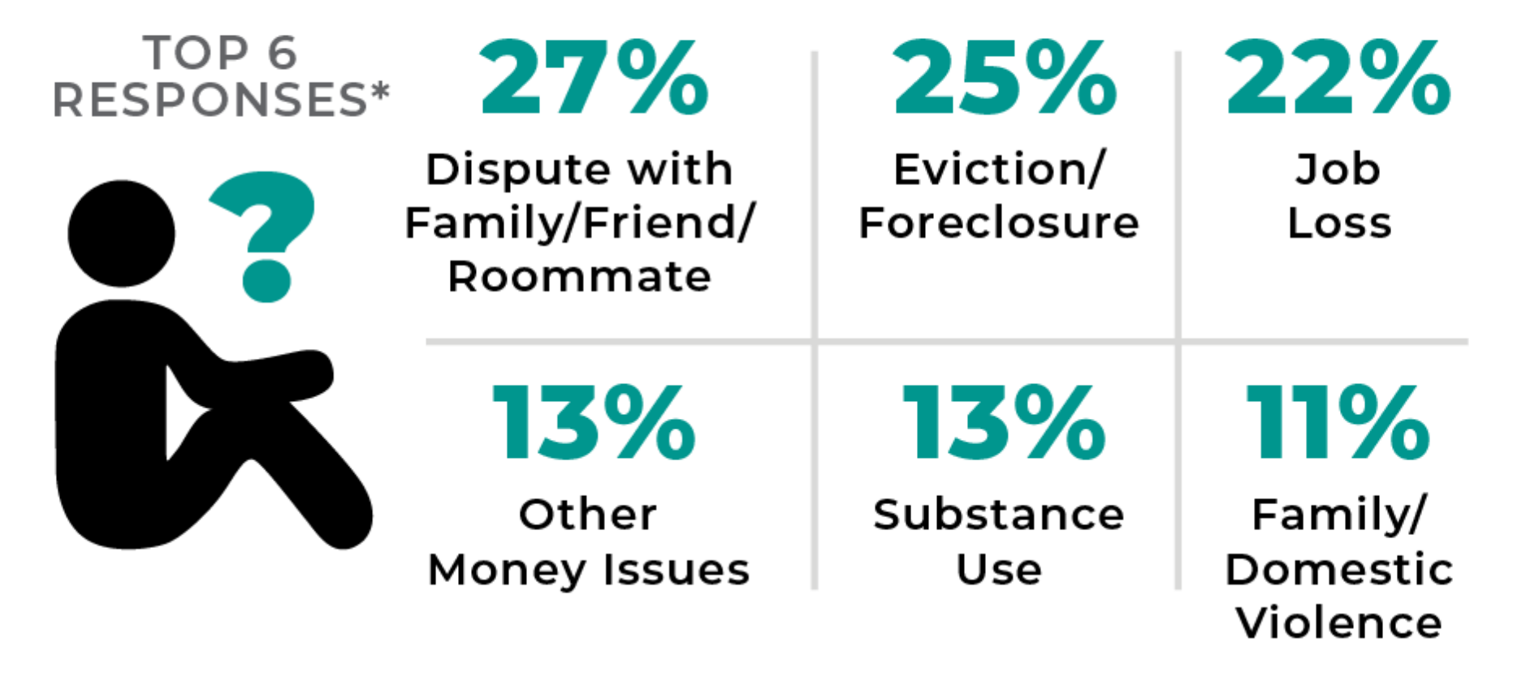
Homelessness is easy to fall into, and difficult to leave.
Primary Cause of Homelessness:
Because the cost of housing is so high, even minor events can send someone on a path towards homelessness.
27% reported a dispute with family or friends.
22% reported a job loss.
11% reported domestic violence.
Once a person enters homelessness it is difficult to leave.
75% of PIT Count participants have been unhoused for more than a year.
Many are seniors and/or disabled, with fixed incomes too low to afford housing.
Duration of Homelessness:

Slide 7
Exposure to Homelessness is Traumatic

Slide 8
People Experiencing Homelessness Die Earlier
Across all causes of death, people experiencing homelessness are dying younger and more often.

Slide 9
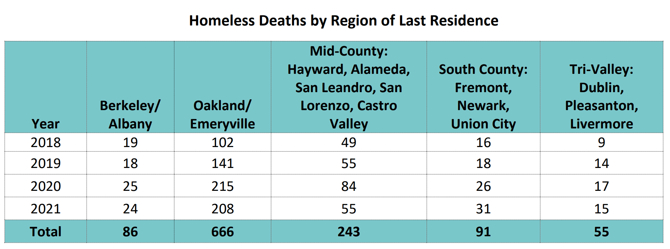
This Is A County-Wide Crisis
Homeless deaths remain high in every region of Alameda County.

Slide 10
Racial Disparities are Prominent in Alameda County Homelessness
Racial Distribution of General Population and Homeless Population
Marginalized groups ,including African-Americans, multi-racial and LGBTQ+ individuals, are all overrepresented in the homeless population, and are several times more likely to become homeless then the general population.

Slide 11
This is an Emergency!

Slide 15
Why Declare a State of Emergency?
Declaring a local emergency could unlock additional tools in helping to expedite a sufficient response to the crisis.
These additional tools could include, but are not limited to:
Accelerated hiring to address homelessness and behavioral health needs
More effective and efficient use of funds
Expedited procurement of critical items
Faster and more streamlined creation of housing
Expanded services, and
The ability to request resources from
the State and Federal governments.

Slide 16
Declaring a Countywide State of Emergency on Homelessness
The action today declares a local emergency to address the homelessness crisis.
It also direct the Health Care Services Agency (HCSA) Office of Homeless Care and Coordination (OHCC) to lead the development of an emergency response to homelessness and report back to the Board of Supervisors within 60 days.

